Slide 1
ELG 5255 Applied ML Project
Dr. Murat Simsek
murat.simsek@uottawa.ca

Slide 2
Agenda
Introduction
Dataset Description
LR, SVM and AdaBoost
Over/Under sampling techniques
Dimensionality Reduction Techniques
Stacking Techniques
MLP Classifier with initial hyperparameters
Feature Selection
Clustering with SOM
Tune hyperparameters
MLP Classifier with Tuned Parameters

Slide 3



Introduction

Slide 4
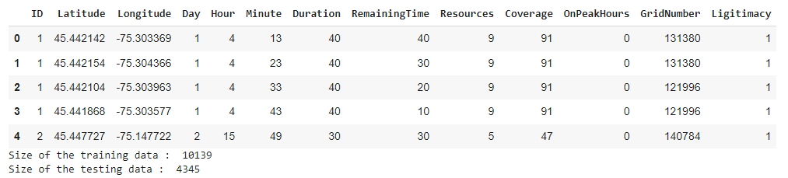
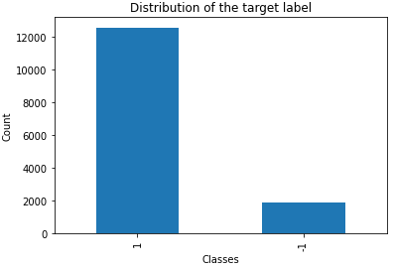

Dataset Description(Mobile CrowdSensing Dataset)

Slide 5
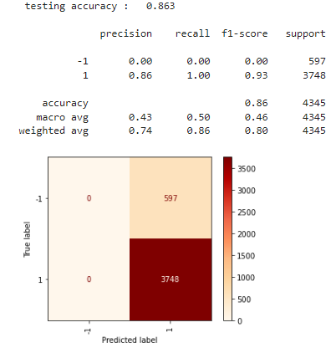
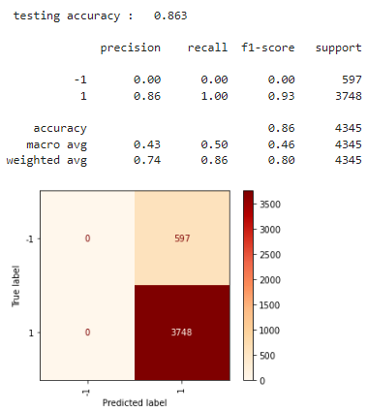
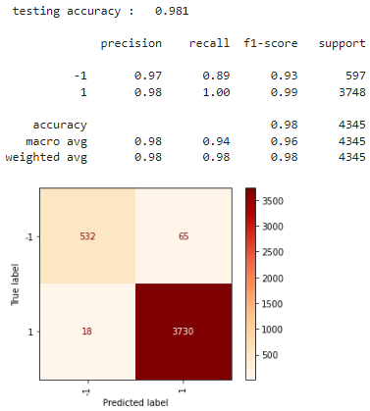
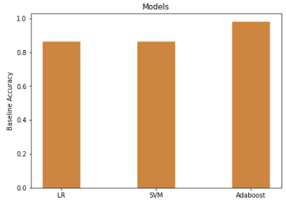
LR, SVM, AdaBoost
Original data without any transformations

Slide 6
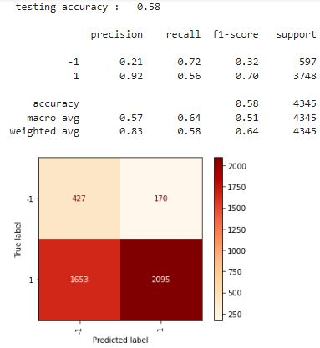
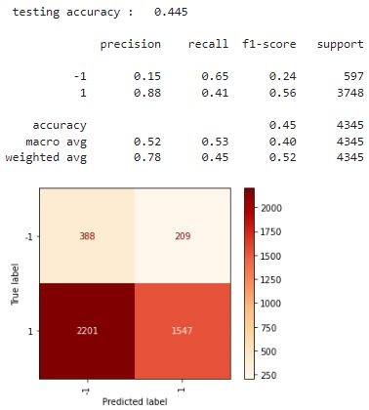
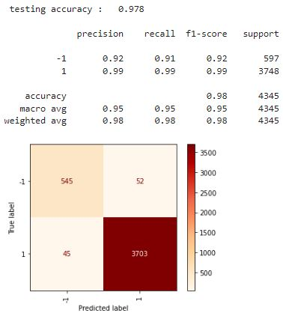
Over/Under Sampling Techniques
Synthetic Minority Oversampling Technique (SMOTE)

Slide 7
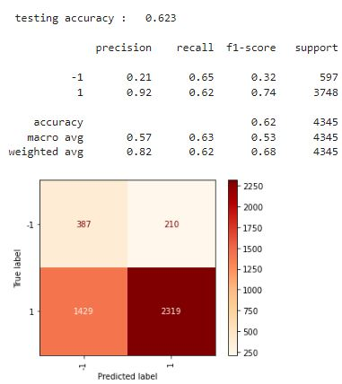
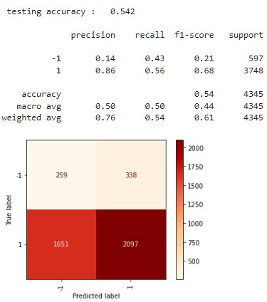
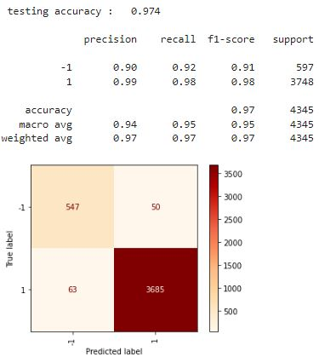
Over/Under Sampling Techniques
Adaptive Synthetic Sampling (ADASYN)

Slide 8
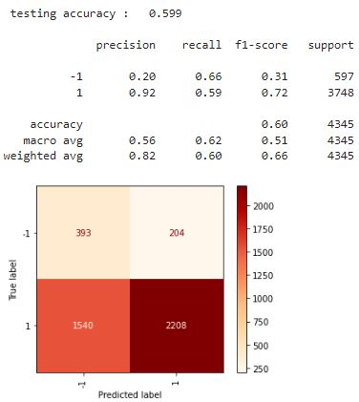
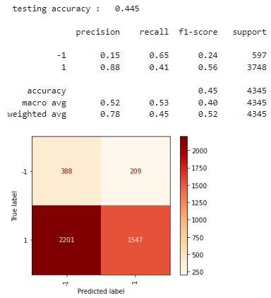
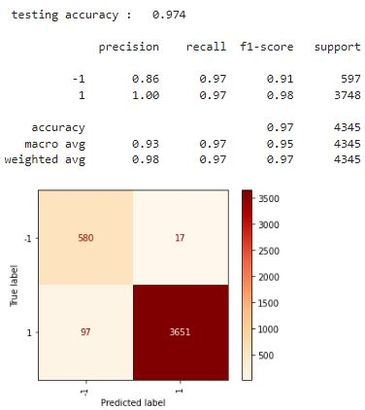
Over/Under Sampling Techniques
Random Under Sampling

Slide 9
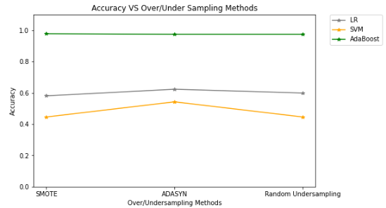
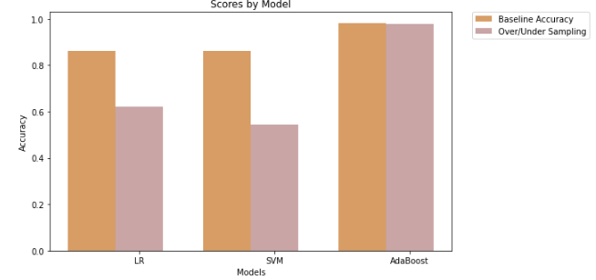
Over/Under Sampling Techniques

Slide 10
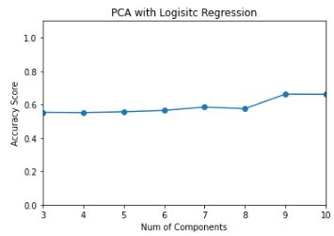
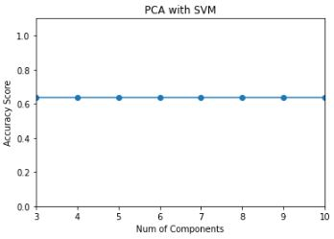
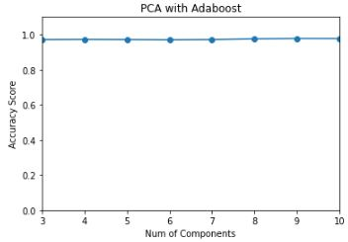
Dimensionality Reduction Techniques
Principal Component Analysis (PCA)
Best Accuracy: 0.660 Best number of Components: 9
Best Accuracy: 0.636 Best number of Components: 3
Best Accuracy: 0.976 Best number of Components: 9

Slide 11
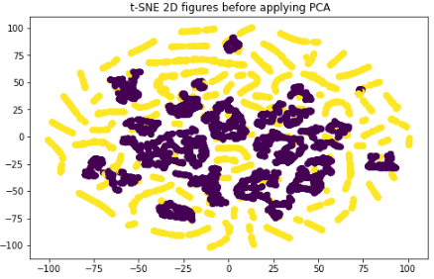
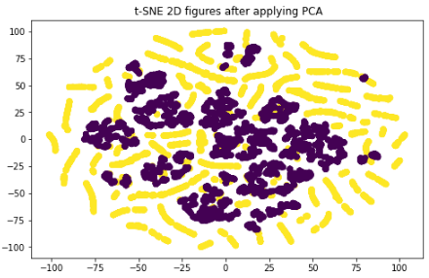
Dimensionality Reduction Techniques
t-distributed stochastic neighbour embedding(T-SNE)

Slide 12
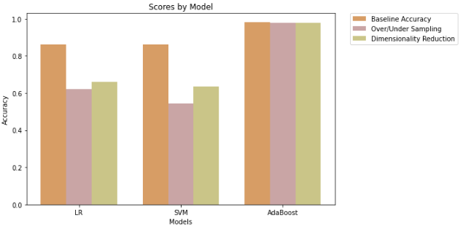
Dimensionality Reduction Techniques
Baseline vs Over/Under Sampling vs Dimensionality Reduction

Slide 13
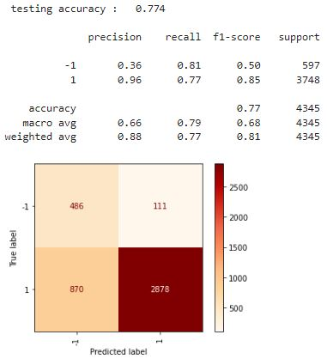
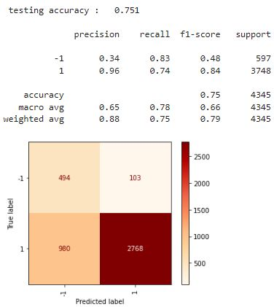
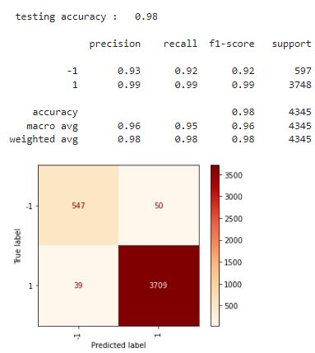
Stacking Techniques

Slide 14
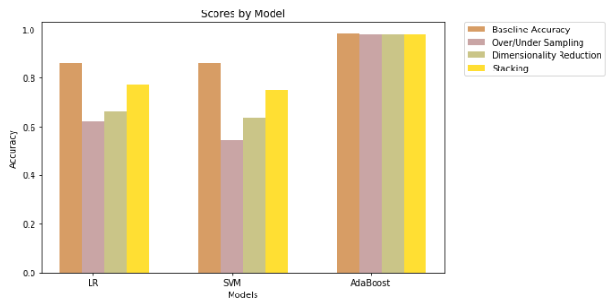
Stacking Techniques

Slide 15
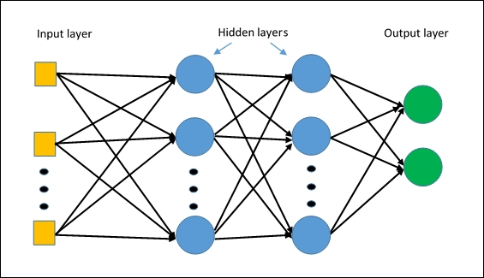

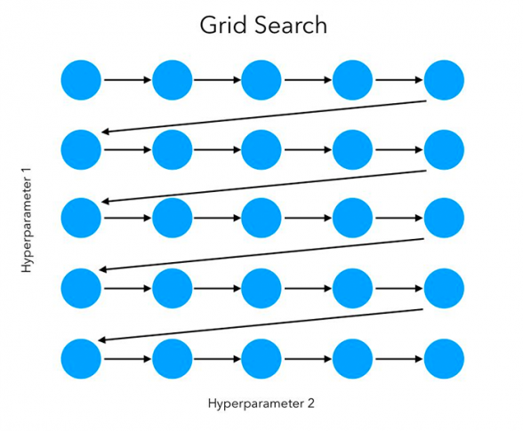
MLP Classifier
Need more computational power
Tune hyperparmeters using grid search

Slide 16
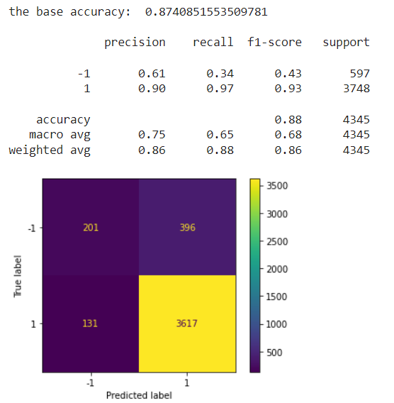
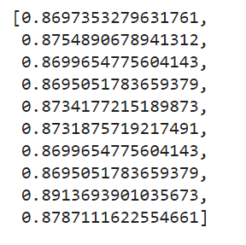
Initial Performance
Tune for activation function and learning rate
Tune hyperparmeters with GridSearchCV
Average of 10 runs accuracies as a base accuracy for next step
Accuracies for 10 runs

Slide 17
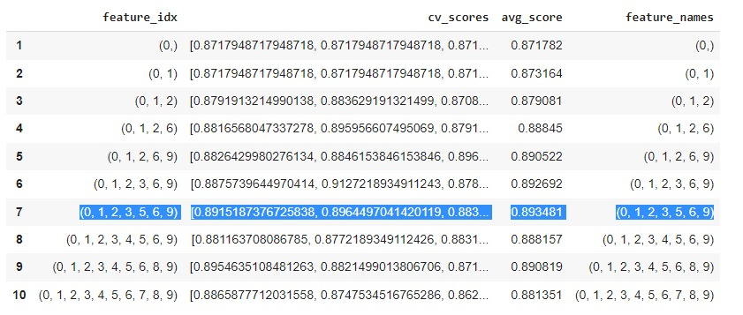
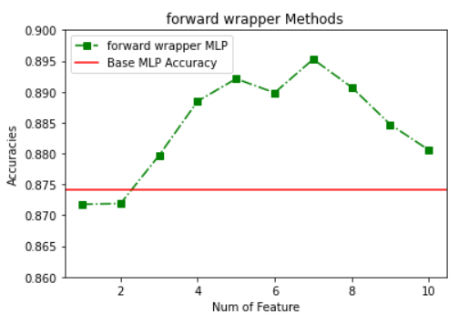
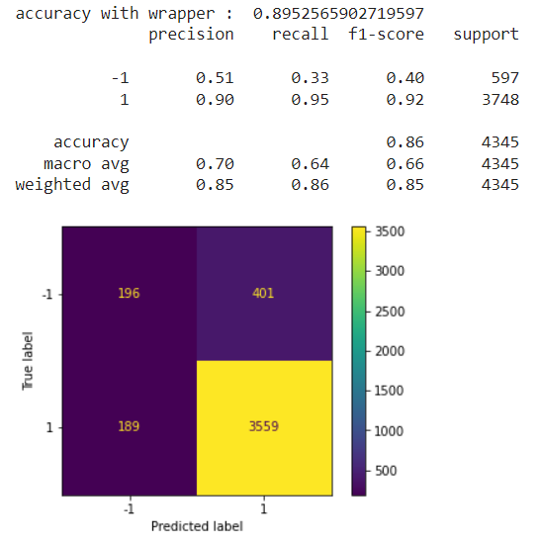
Feature Selection
Wrapper method to select best feature combination to train MLP

Slide 18
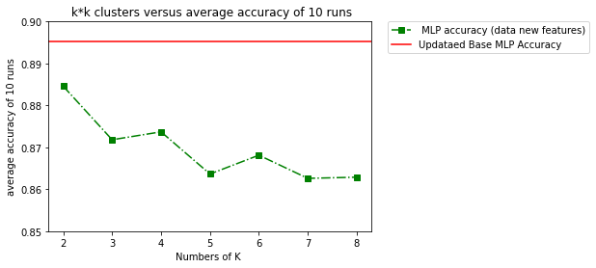
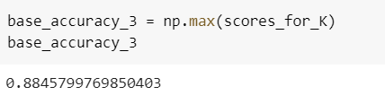
Clustering with SOM
Add the clustering results as a new feature to the selected features
Best number of cluster is 4

Slide 19
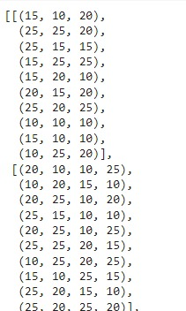
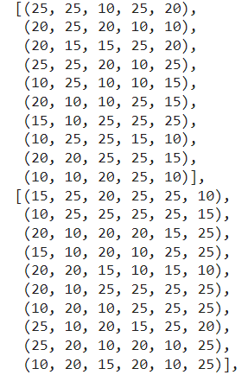
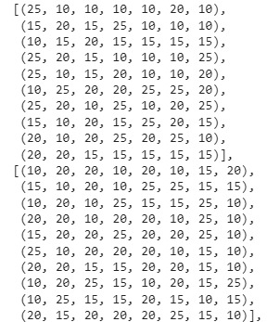
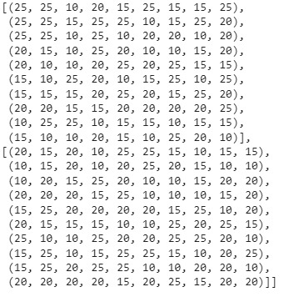
Tune the number of hidden layers and neurons

Slide 20
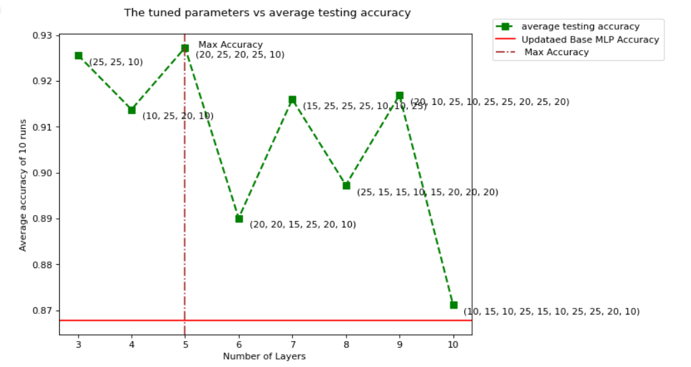
Best number of layers and neurons for MLP Classifier

Slide 21
Conclusion
Resampling techniques can help in solving the imbalanced data.
Dimensionality reduction (PCA) helps in improving the model ‘s performance.
Pipelines with stacking improves the accuracy of the models.
Combination of feature selection ,clustering and tune the hyperparameters can significantly improve model performance.

